Slide 1

Effective resource management with AWS Config
November 2023
Notes:
Today we see how we can use AWS Config to effectively manage your resources

Slide 2
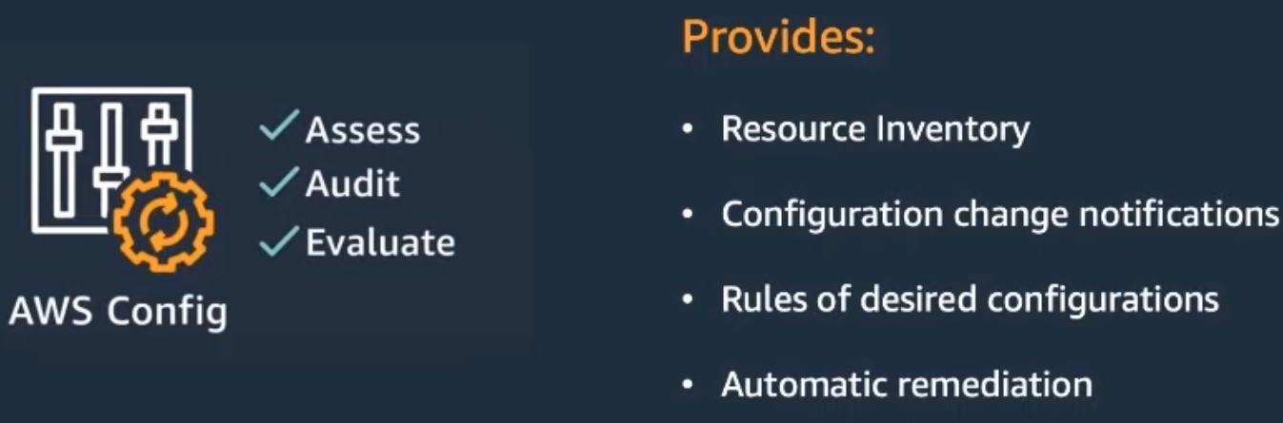
What is AWS Config?
Notes:
AWS Config provides a way to Assess, Audit, and Evaluate the configuration of the resources in your account to maintain security, compliance, and governance
It allows you to apply rules, receive notifications, and provide remediation policies when resources in your account deviate from a compliance state

Slide 3
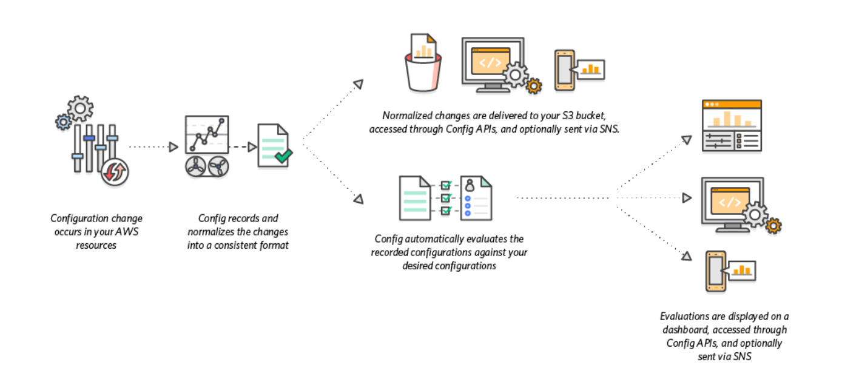
How AWS Config works
Notes:
AWS Config discovers supported resources through the Describe and List API calls
A configuration item is created, and the Configuration Recorder maintains historical records in S3 whenever the configuration of a resource changes
With AWS Config Rules, the recorded configuration is evaluated against the desired configuration to determine whether a resource is COMPLIANT or NON-COMPLIANT
Remediation actions can be taken on non-compliant resources to get them back to a compliant state
We can also manage multiple rules and simplify deployment across Accounts and Regions with the use of Conformance Packs

Slide 4
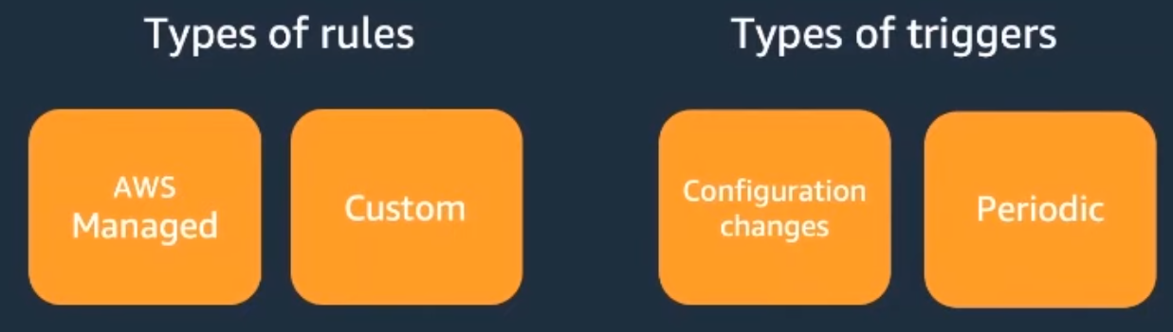
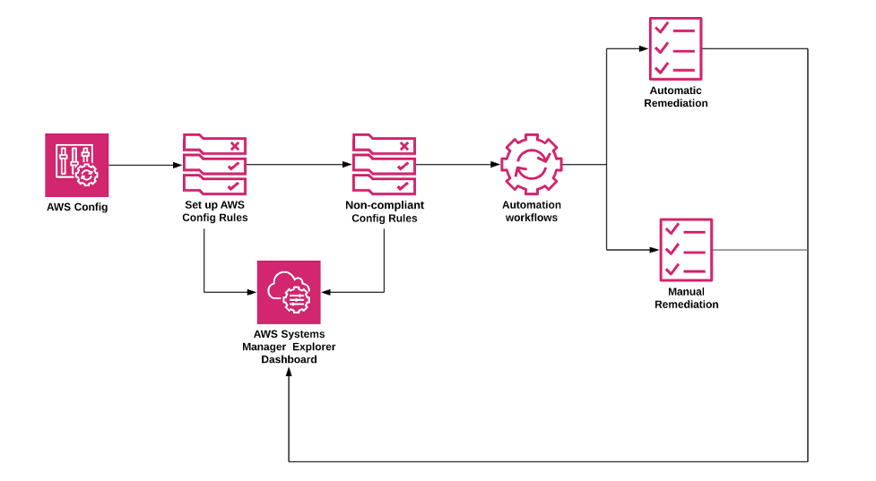
AWS Config Rules and Remediation
Notes:
Resource configuration is evaluated with AWS Config rules
These rules can either be
Managed Rules, which are pre-defined and customizable rules created by AWS
Custom Rules, that can be authored with Lambda or Guard
There are two triggers in which rules are evaluated
With Configuration Changes, the rule is evaluated whenever the configuration of a resource changes
A Periodic trigger allows evaluation at a set frequency
>Remediation of non-compliant resources can be applied through SSM Automation Documents

Slide 5

Problem
Lambda Hyperplane ENIs are created for each Security Group and Subnet combination
We make the most efficient use of our ENI quota by sharing the same Security Group and Subnet combination
Notes:
With AWS Config we can configure a Custom Rule to ensure we maintain the desired network configuration of our Lambda functions to limit our ENI usage
Let’s see how we can do that now

Slide 6











aws-config-lambda-shared-eni
Change Configuration Item
AWS Lambda
API
Rule
AWS CloudTrail
Events
AWS Config
Console
COMPLIANT
NON COMPLIANT
Amazon EventBridge
Amazon SNS
Notes:
> When a Lambda function changes either from the API or in the Console an event is logged in CloudTrail Events
> Configuration Recorder creates a configuration item and the associated AWS Config Custom Rule is evaluated
> This rule evaluates whether the configuration item has the correct Security Group and Subnet combination
> A resulting PutEvaluation API call is made to update the configuration status with AWS Config
> The configuration status is then either marked as COMPLIANT or NON-COMPLIANT
> We can also subscribe a SNS Topic with an email subscription to the EventBridge event from AWS Config for any notifications

Slide 7
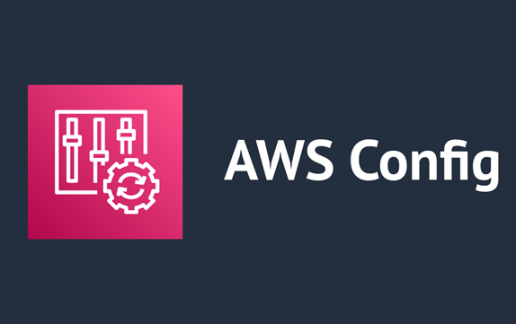
🔌Demo Time 🔨

Slide 8
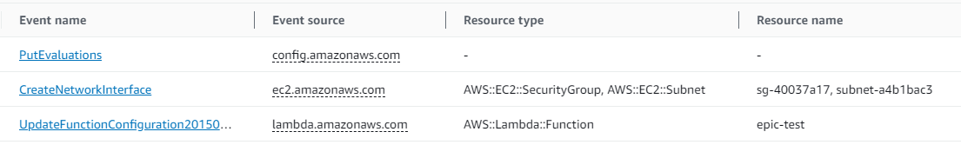
1. CloudTrail Events
Notes:
Here we see the `epic-test` Lambda function is updated (the bottom event)
A Subnet is removed from the VPC configuration of the Lambda function, shown in the middle event
The top event shows AWS Config performed a PutEvaluations API call to update the configuration status of the configuration item

Slide 9
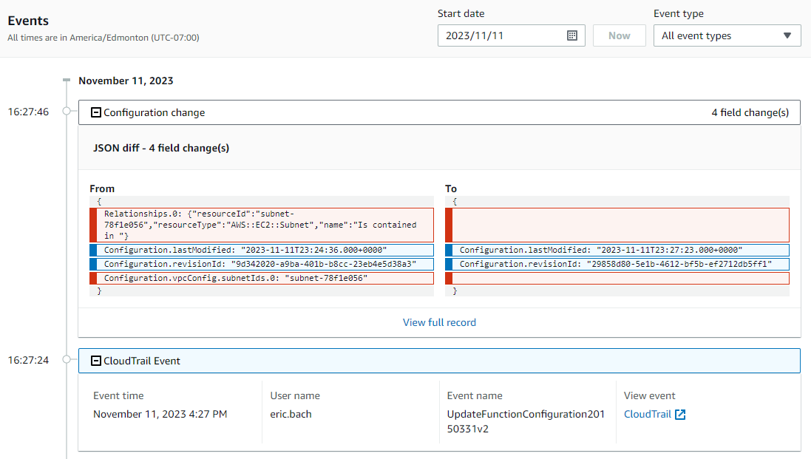
2. Resource Timeline
Notes:
The Resource Timeline of the configuration item shows the CloudTrail Event as well as the recorded configuration change to the network configuration

Slide 10
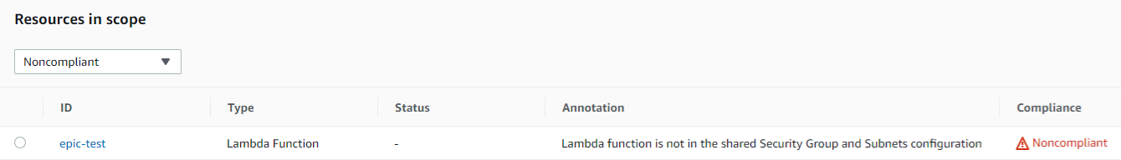
3. Compliant Status
Notes:
When we check the resource, `epic-test`, in AWS Config we see the function is now marked as Noncompliant with the custom Annotation we specified in our AWS Config Custom Rule

Slide 11
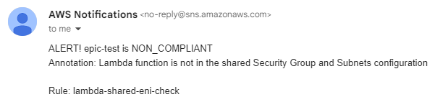
4. Notification
Notes:
This also sends a message to the SNS Topic with an email subscription to notify us of the mis-configuration

Slide 12
Thanks!
Feedback/Questions?
👍

